Slide 1
Hackathon 2022: Name Pronunciation
High level Design Approach
(Challengers Squad)

Slide 2
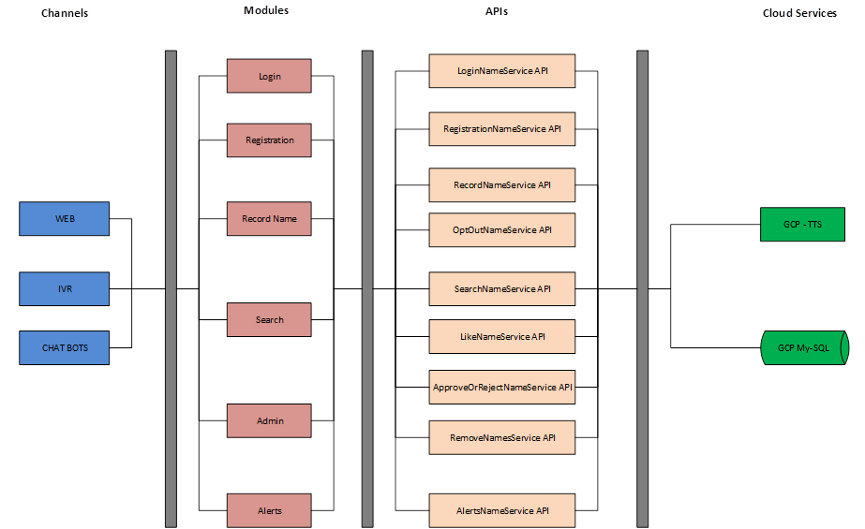
High Level Design

Slide 3
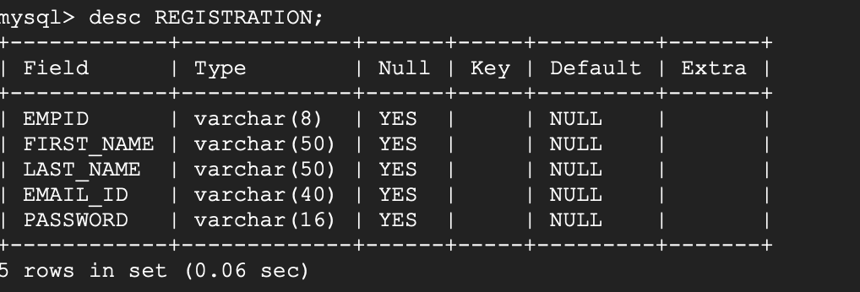
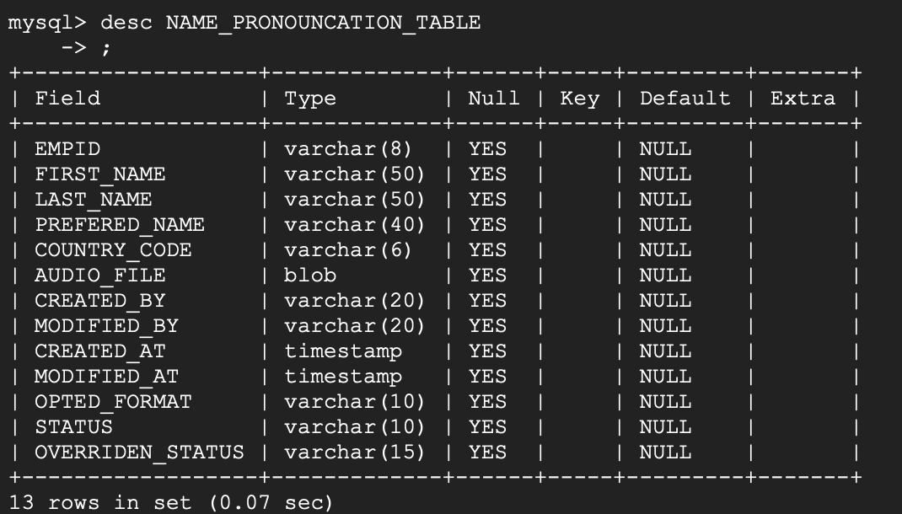
Database Tables

Slide 4
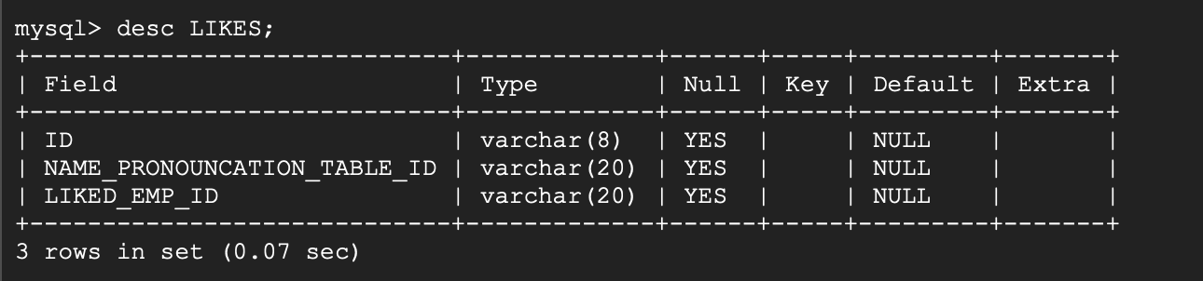
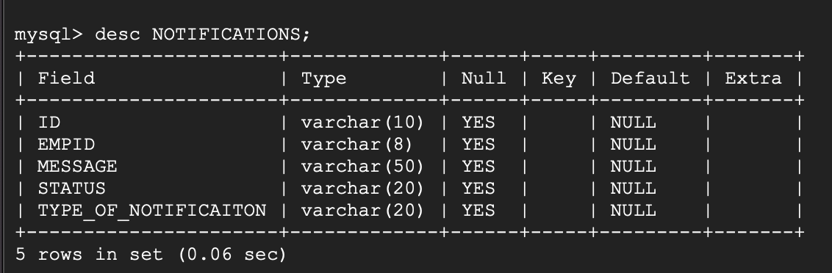
Database Tables – continue…

